Slide 1
TURF MANAGEMENT
SAYUJ A.P
Roll No.47
Product Owner:Ms. Febin Aziz

Slide 2
TABLE OF CONTENTS
Introduction
Modules
Data Flow Diagram
Developing Environment
Product Backlog
User Stories
Project Plan
Sprint Plans
Sprint Actual

Slide 3
TURF MANAGEMENT
This project is helpful to get to manage the activity of turf.
This application can be used by the Cricket and Football enthusiastic players to book the available turf according to their need.
This application not only helps the players but also the turf owners who want to expand their business through online medium.
Maintain the List of Turf and Booking History so it will be easy to access any time 24*7.

Slide 4
MODULES
ADMIN
Login
Register and manage Turf locations
Register and Manage Turf managers
View feedback
View complaints and post reply
MANAGER
Login
Register time slot with fees
View booking and manage
View payment

Slide 5
MODULES
USER
Register
Login
View turf locations
Book turf
View booking status
Add payment
Post feedback
Post complaint and view reply

Slide 6
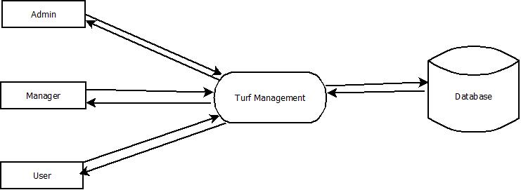
Data Flow Diagram
Level - 0

Slide 7
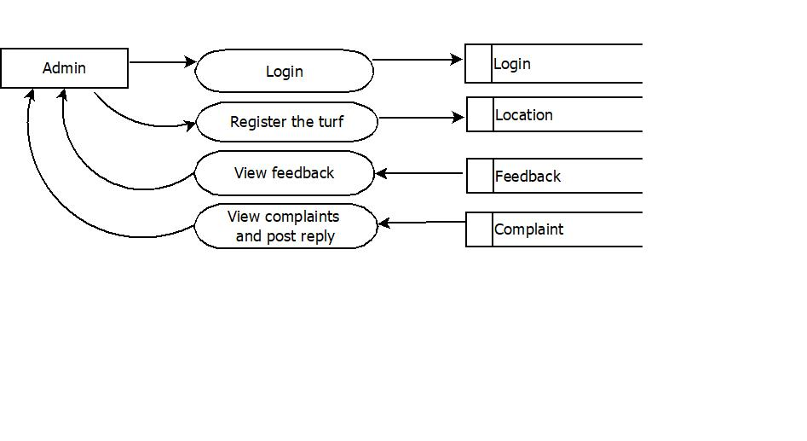
Level – 1 : Admin

Slide 8
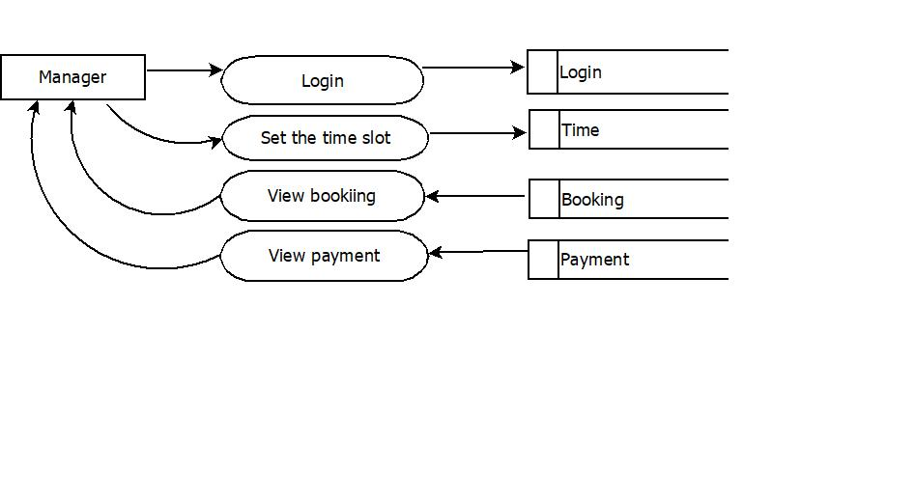
Level – 2 : Manager

Slide 9
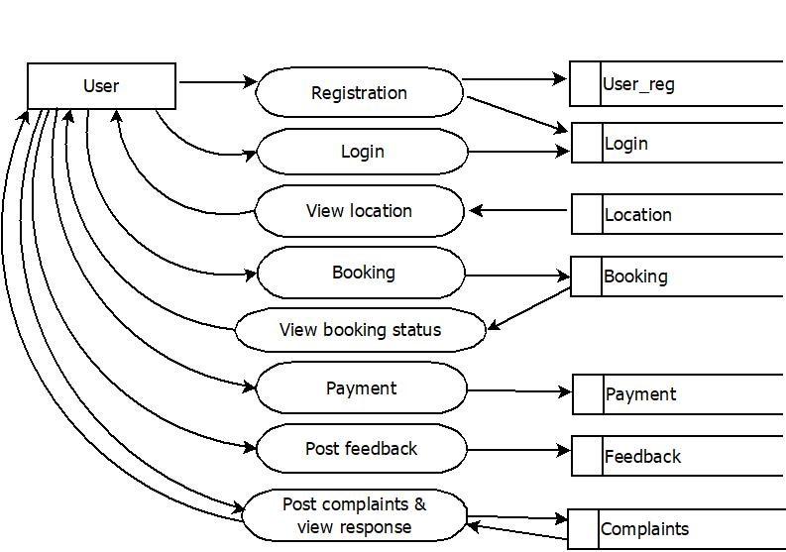
Level – 3 : User

Slide 10
DEVELOPING ENVIRONMENT
Language: Python
Front End: Html,CSS,Java script
Back end: Python-django
Database : MySQL
IDE: PyCharm
OS: Windows/Linux

Slide 11
PRODUCT BACKLOG
User story ID | Priority <High/Medium/Low> | Size (Hours) | Sprint <#> | Status <Planned/In progress/Completed> | Release Date | Release Goal
1 | Medium | 3 | 1 | Completed | 19-11-2021 | Home page of admin
2 | High | 4 |  | Completed | 20-11-2021 | Add turf details
3 | Medium | 3 | 2 | Planned | 30-11-2021 | Home page of manager
4 | High | 4 |  | Planned | 04-12-2021 | Manager set the time slot
5 | Medium | 2 |  | Planned | 08-12-2021 | User registration
6 | Medium | 3 |  | Planned | 11-12-2021 | Login to the system
7 | Medium | 2 |  | Planned | 18-12-2021 | View the turf details
8 | Medium | 3 | 3 | Planned | 24-12-2021 | Book the turf
9 | Medium | 2 |  | Planned | 27-12-2021 | View booking details
10 | High | 4 |  | Planned | 31-12-2021 | Status updates

Slide 12
User story ID | Priority <High/Medium/Low> | Size (Hours) | Sprint <#> | Status <Planned/In progress/Completed> | Release Date | Release Goal
11 | Medium | 3 | 3 | Planned | 08-01-2022 | View booking details
12 | High | 4 |  | Planned | 15-01-2022 | Make payments
13 | Medium | 2 |  | Planned | 19-01-2022 | View the payment details
14 | Medium | 3 |  | Planned | 22-01-2022 | Post feedback
15 | Medium | 3 |  | Planned | 31-01-2022 | View feedback
16 | Medium | 3 | 4 | Planned | 05-02-2022 | Post complaints and view response
17 | Medium | 2 |  | Planned | 12-02-2022 | View complaints and send response

Slide 13
USER STORY
User story ID | As a <type of user> | I want to <perform some task> | So that I can <achieve some goal>
1 | Admin | Access home page and login | Home page of admin access the system
2 | Admin | Registering the turf | Admin can register the available turf
3 | Manager | Access home page and login | Home page of manager access the turf details
4 | Manager | Setting the time slot | Manager can set the time for playing
5 | User | Registration | Register to the system and create profile
6 | User | Login and access home page | Access the system
7 | User | View the turf details | View turf is available or not
8 | User | Book the turf | Book the turf
9 | Manager | View bookings | View the booking details
10 | Manager | Status updates | Send the details to users

Slide 14
User story ID | As a <type of user> | I want to <perform some task> | So that I can <achieve some goal>
11 | User | View booking | View booking details
12 | User | Make payment | Pay the amount
13 | Manager | View payment details | View the payment details
14 | User | Post feedback | Post feedback
15 | Admin | View feedback | View feedback
16 | User | Post complaints | Post complaints and view feedback
17 | Admin | View complaints | View complaints and post response

Slide 15
PROJECT PLAN
User Story ID | Task Name | Start Date | End Date | Days | Status
1 | Sprint 1 | 15-11-2021 | 19-11-2021 | 5 | Completed
2 |  | 17-11-2021 | 20-11-2021 |  | Completed
3 | Sprint 2 | 24-11-2021 | 30-11-2021 | 25 | Planned
4 |  | 01-12-2021 | 04-12-2021 |  | Planned
5 |  | 06-12-2021 | 08-12-2021 |  | Planned
6 |  | 08-12-2021 | 11-12-2021 |  | Planned
7 |  | 13-12-2021 | 18-12-2021 |  | Planned
8 | Sprint 3 | 20-12-2021 | 24-12-2021 | 43 | Planned
9 |  | 22-12-2021 | 27-12-2021 |  | Planned
10 |  | 27-12-2021 | 31-12-2021 |  | Planned

Slide 16
User Story ID | Task Name | Start Date | End Date | Days | Status
11 | Sprint 3 | 03-01-2022 | 08-01-2022 | 43 | Planned
12 |  | 10-01-2022 | 15-01-2022 |  | Planned
13 |  | 12-01-2022 | 19-01-2022 |  | Planned
14 |  | 17-01-2022 | 22-01-2022 |  | Planned
15 |  | 24-01-2022 | 31-01-2022 |  | Planned
16 | Sprint 4 | 02-02-2022 | 05-02-2022 | 11 | Planned
17 |  | 08-02-2022 | 12-02-2022 |  | Planned

Slide 17
SPRINT BACKLOG ACTUAL
Backlog Item | Status and Completion date | Original Estimate in hours | Day 1 | Day 2 | Day 3 | Day 4 | Day 5 | Day 6 | Day 7 | Day 8 | Day 9 | Day 10 | Day 11 | Day 12 | Day 13 | Completed <Y/N>
User story #1,2 |  |  | Hours | Hours | Hours | Hours | Hours | Hours | Hours | Hours | Hours | Hours | Hours | Hours | Hours
Dataset Collection | 19/11/21 | 3 | 1 | 2 | 0 | 0 | 0 | 0 | 0 | 0 | 0 | 0 | 0 | 0 | 0 | Y
Analysis | 20/11/21 | 4 | 2 | 2 | 0 | 0 | 0 | 0 | 0 | 0 | 0 | 0 | 0 | 0 | 0 | Y
User story #3,4,5,6,7
UI Designing | 30/11/21 | 11 | 2 | 2 | 2 | 2 | 2 | 1 | 0 | 0 | 0 | 0 | 0 | 0 | 0 | N
Coding | 18/12/21 | 11 | 2 | 2 | 2 | 2 | 2 | 1 | 0 | 0 | 0 | 0 | 0 | 0 | 0 | N
User story #8,9,10,11,12,13,14,15
Training | 31/01/22 | 18 | 2 | 2 | 2 | 2 | 2 | 2 | 2 | 2 | 2 | 0 | 0 | 0 | 0 | N
User story #16,17
Testing | 12/02/22 | 3 | 1 | 2 | 0 | 0 | 0 | 0 | 0 | 0 | 0 | 0 | 0 | 0 | 0 | N
Total |  | 50 | 10 | 12 | 6 | 6 | 6 | 4 | 2 | 2 | 2 | 0 | 0 | 0 | 0

Slide 18
SPRINT BACKLOG PLAN
Backlog Item | Status and Completion date | Original Estimate in hours | Day 1 | Day 2 | Day 3 | Day 4 | Day 5 | Day 6 | Day 7 | Day 8 | Day 9 | Day 10 | Day 11 | Day 12 | Day 13 | Day 14
User story #1,2 |  |  | Hours | Hours | Hours | Hours | Hours | Hours | Hours | Hours | Hours | Hours | Hours | Hours | Hours | Hours
Dataset Collection | 19/11/21 | 3 | 1 | 2 | 0 | 0 | 0 | 0 | 0 | 0 | 0 | 0 | 0 | 0 | 0 | 0
Analysis | 20/11/21 | 4 | 2 | 2 | 0 | 0 | 0 | 0 | 0 | 0 | 0 | 0 | 0 | 0 | 0 | 0
User story #3,4,5,6,7
UI Designing | 30/11/21 | 11 | 2 | 2 | 2 | 2 | 2 | 1 | 0 | 0 | 0 | 0 | 0 | 0 | 0 | 0
Coding | 18/12/21 | 11 | 2 | 2 | 2 | 2 | 2 | 1 | 0 | 0 | 0 | 0 | 0 | 0 | 0 | 0
User story #8,9,10,11,12,13,14,15
Training | 31/01/22 | 18 | 2 | 2 | 2 | 2 | 2 | 2 | 2 | 2 | 2 | 0 | 0 | 0 | 0 | 0
User story #16,17
Testing | 12/02/22 | 3 | 1 | 2 | 0 | 0 | 0 | 0 | 0 | 0 | 0 | 0 | 0 | 0 | 0 | 0
Total |  | 50 | 10 | 12 | 6 | 6 | 6 | 4 | 2 | 2 | 2 | 0 | 0 | 0 | 0 | 0

Slide 19
THANK YOU

